Slide 1
Spherical/Cylindrical Coordinates

Slide 2
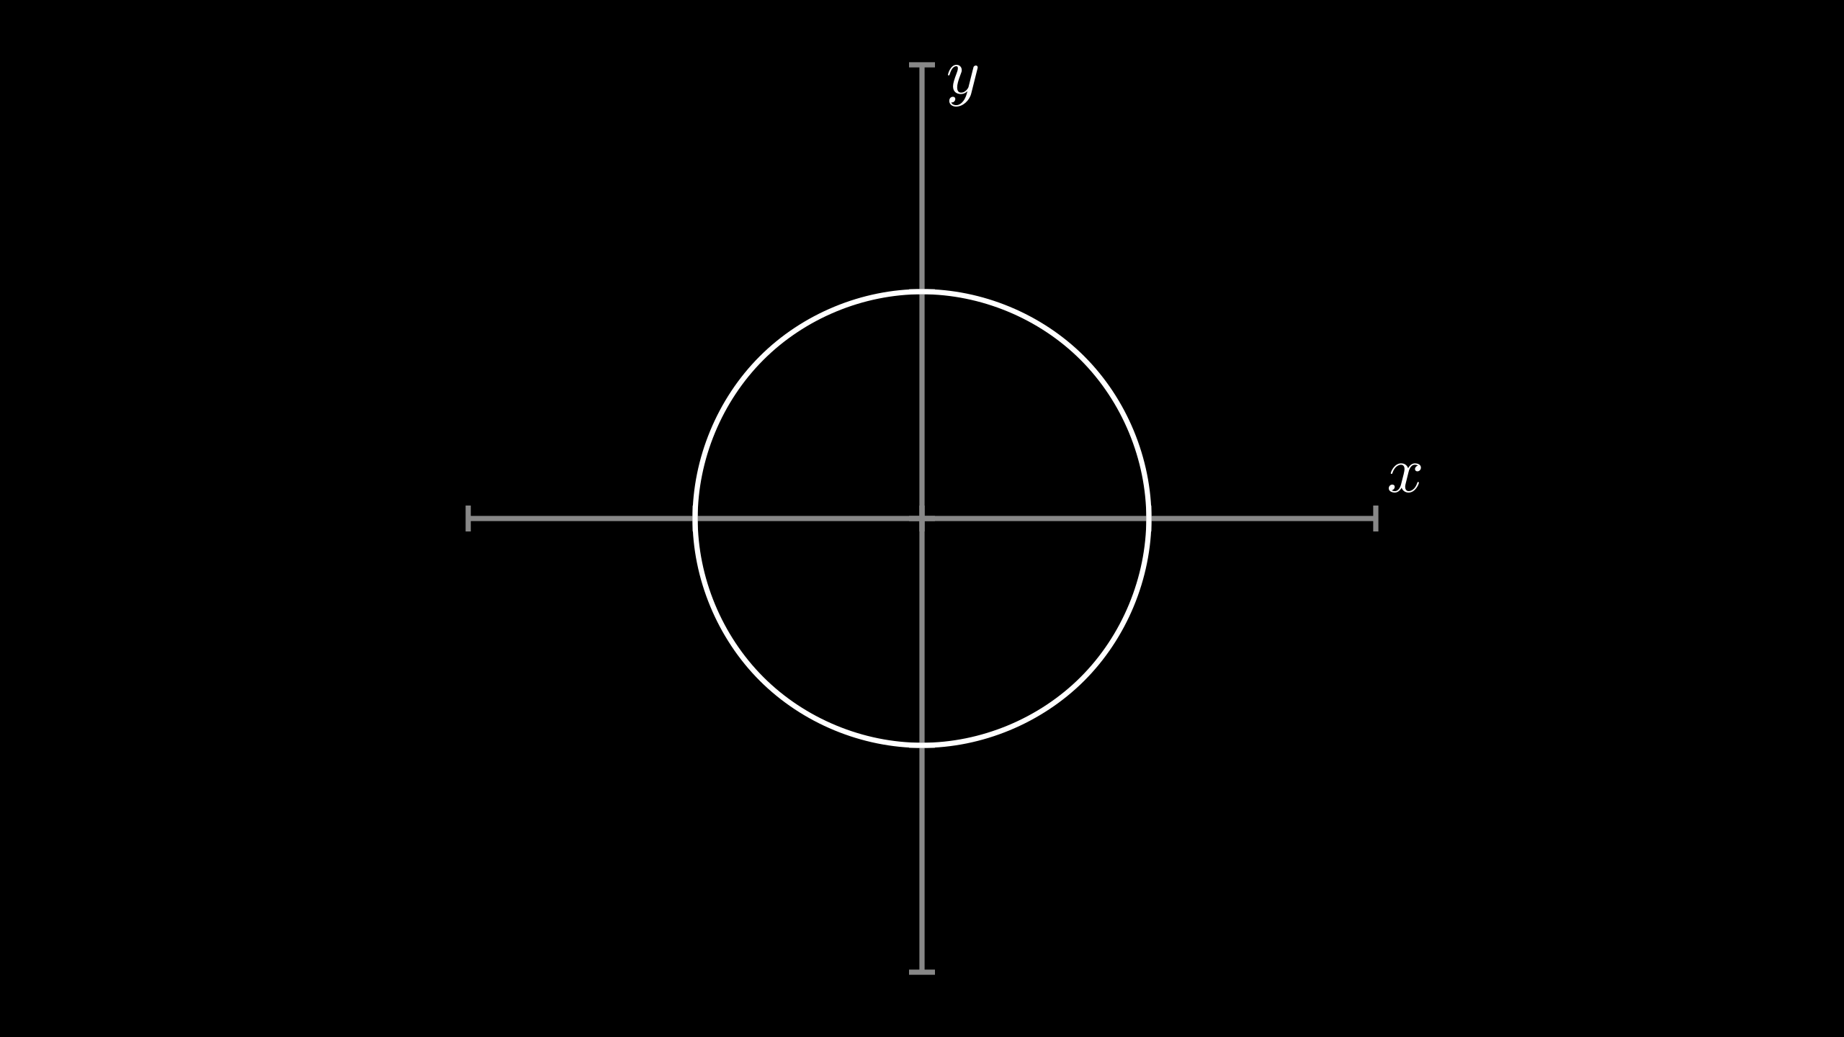
Recall from Lesson 1...
{x[t], y[t]} = {Cos[t], Sin[t]}

Slide 3
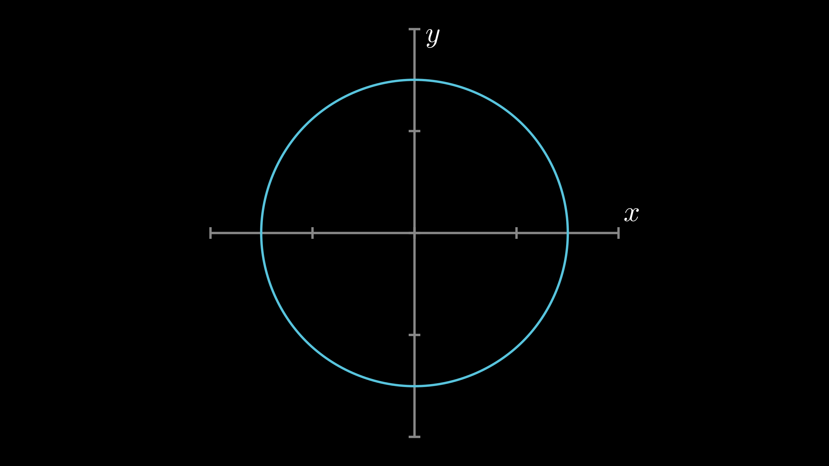
Recall from Lesson 1...
{x[t], y[t]} = {1.5 Cos[t], 1.5 Sin[t]}

Slide 4
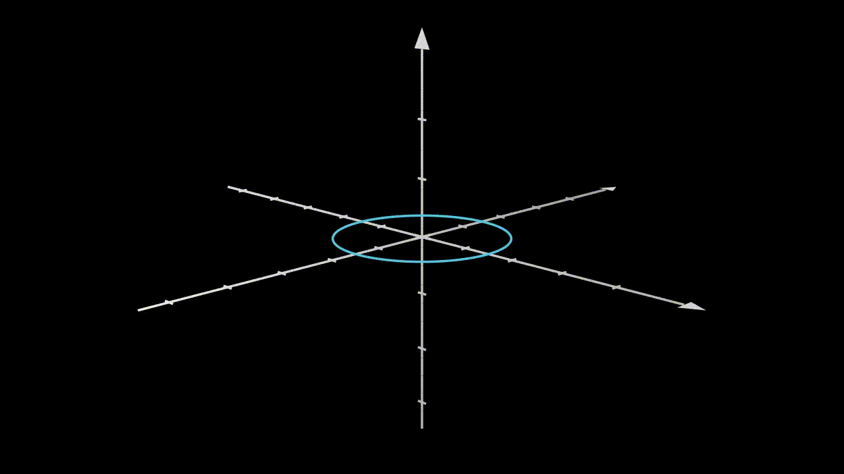
Adding a Height
{x[s, t], y[s, t], z[s, t]} = {1.5 Cos[t], 1.5 Sin[t], s}

Slide 5
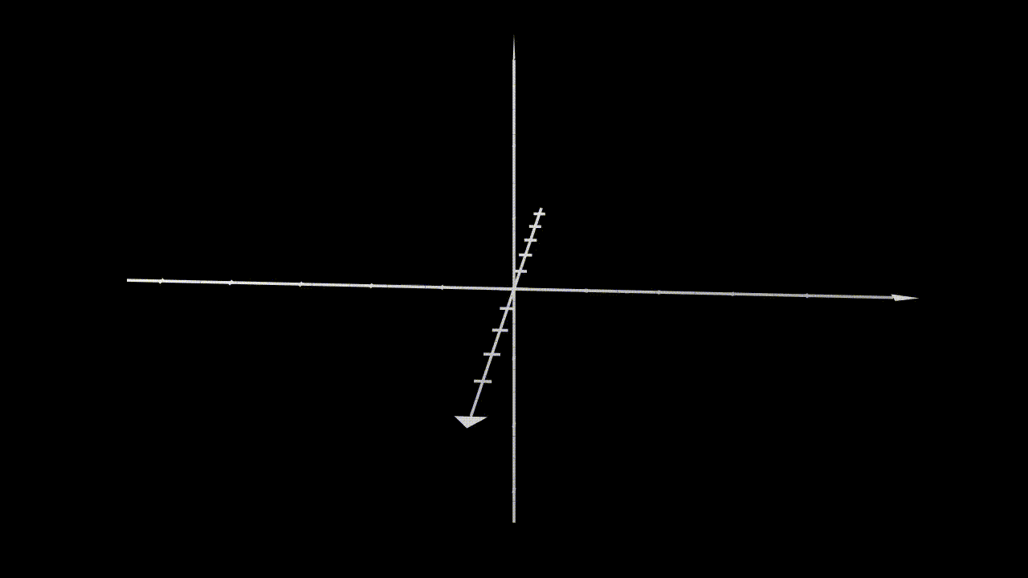
Cylindrical Coordinates
{x[r, s, t], y[r, s, t], z[r, s, t]} = {r Cos[t], r Sin[t], s}

Slide 6
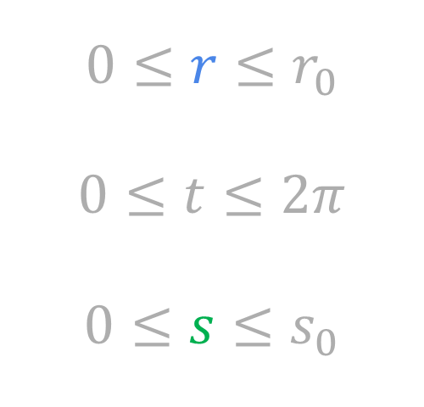
Bounds
x[r, s, t] = r Cos[t]
y[r, s, t] = r Sin[t]
z[r, s, t] = s
$$0≤r≤r_{0}$$
$$0≤t≤2π$$
$$0≤s≤s_{0}$$

Slide 7
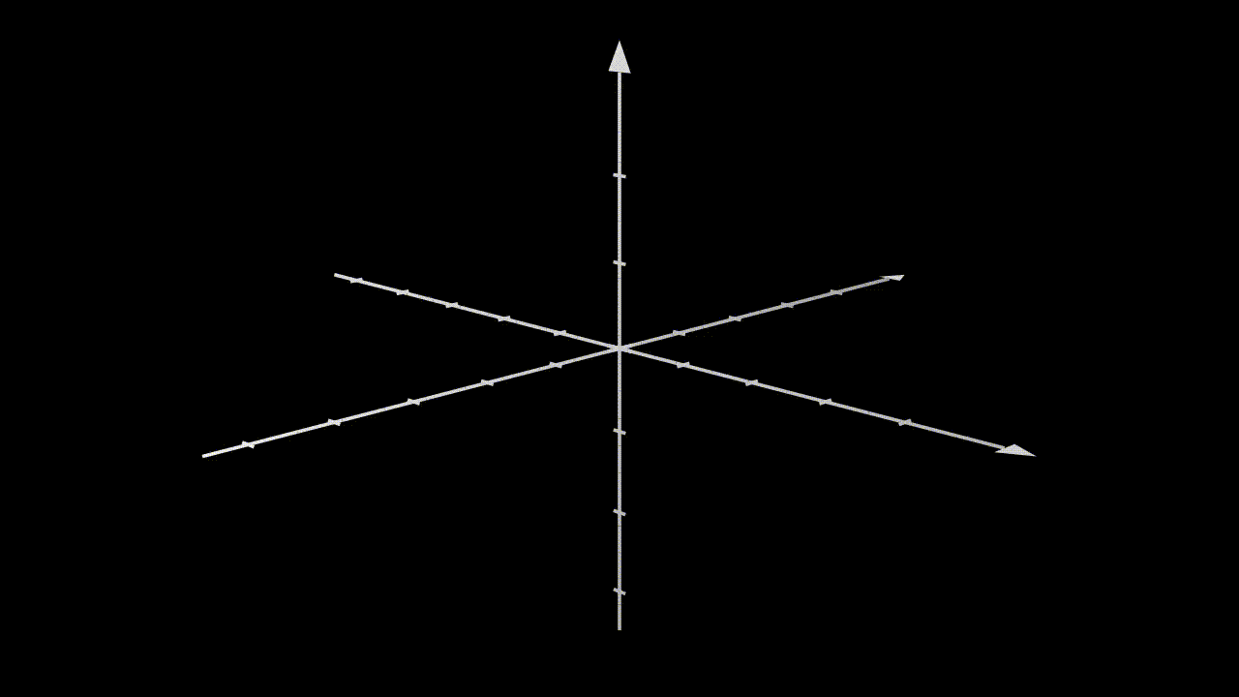
Putting it All Together
{x[r, s, t], y[r, s, t], z[r, s, t]} = {r Cos[t], r Sin[t], s}

Slide 8
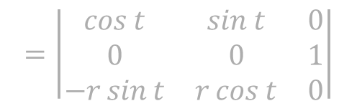
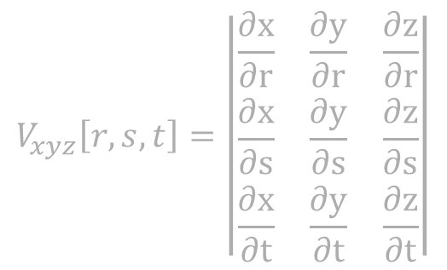
$$|V_{xyz}\left[r,s,t\right]|$$
{x[r, s, t], y[r, s, t], z[r, s, t]} = {r Cos[t], r Sin[t], s}
$$V_{xyz}\left[r,s,t\right]=\left|\begin{matrix}\frac{∂x}{∂r} & \frac{∂y}{∂r} & \frac{∂z}{∂r} \\ \frac{∂x}{∂s} & \frac{∂y}{∂s} & \frac{∂z}{∂s} \\ \frac{∂x}{∂t} & \frac{∂y}{∂t} & \frac{∂z}{∂t}\end{matrix}\right|$$
$$=\left|\begin{matrix}\cos{t} & \sin{t} & 0 \\ 0 & 0 & 1 \\ −r\sin{t} & r\cos{t} & 0\end{matrix}\right|$$
$$\cos{t}\left|\begin{matrix}0 & 1 \\ r\cos{t} & 0\end{matrix}\right|−\sin{t}\left|\begin{matrix}0 & 1 \\ −r\sin{t} & 0\end{matrix}\right|$$

Slide 9

$${|V}_{xyz}\left[r,s,t\right]|$$
$$=r$$
Notes:
ACTUALLY YIELDS –r BUT WE USE ABSOLUTE VALUE INSTEAD

Slide 10


A Familiar Problem
Find the volume of the region bounded by $z=1−x^{2}−y^{2}$ and the $xy$-plane.

Slide 11
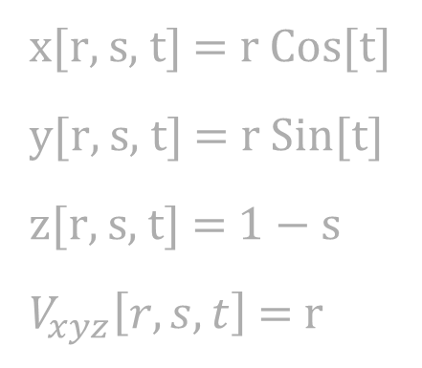
A Familiar Problem
Find the volume of the region bounded by $z=1−x^{2}−y^{2}$ and the $xy$-plane.
x[r, s, t] = r Cos[t]
y[r, s, t] = r Sin[t]
z[r, s, t] = $1−$ s
$V_{xyz}\left[r, s, t\right]$ = r

Slide 12
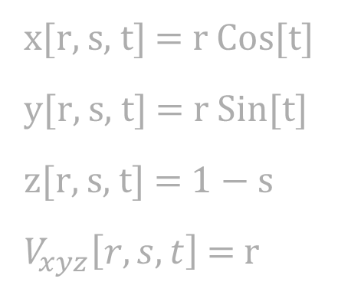
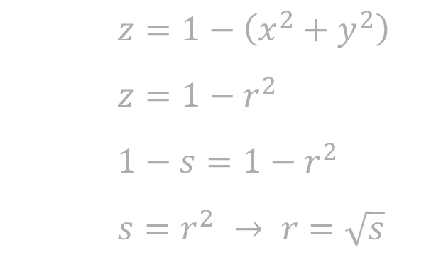
A Familiar Problem
Find the volume of the region bounded by $z=1−x^{2}−y^{2}$ and the $xy$-plane.
x[r, s, t] = r Cos[t]
y[r, s, t] = r Sin[t]
z[r, s, t] = $1−$ s
$V_{xyz}\left[r, s, t\right]$ = r
$z=1−\left(x^{2}+y^{2}\right)$
$z=1−r^{2}$
$1−s=1−r^{2}$
$s=r^{2}$ $→ r=\sqrt{s}$

Slide 13

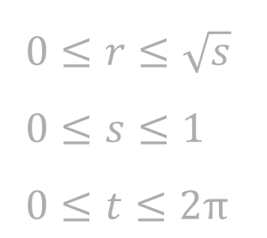
A Familiar Problem
Find the volume of the region bounded by $z=1−x^{2}−y^{2}$ and the $xy$-plane.
$\iiint_{R_{xyz}}{1} \text{d}x \text{d}y \text{d}z=\iiint_{R_{rst}}{\left|V_{xyz}\left[r,s,t\right]\right|} \text{d}r \text{d}s \text{d}t$
$=\int_{0}^{2π}{\int_{0}^{1}{\int_{0}^{\sqrt{s}}{r} \text{d}r} \text{d}s} \text{d}t$
$=\frac{π}{2}$
$0≤r≤\sqrt{s}$
$0≤s≤1$
$0≤t≤2π$

Slide 14
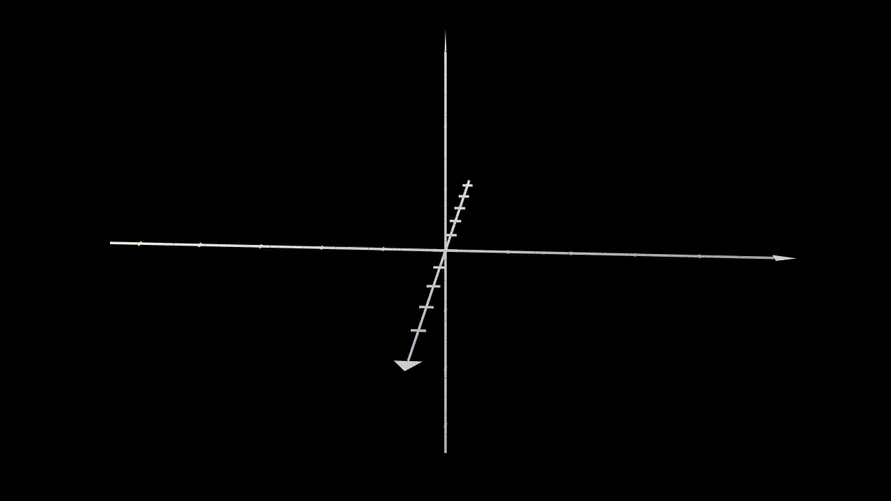

Spherical Coordinates
New $r$, $s$

Slide 15
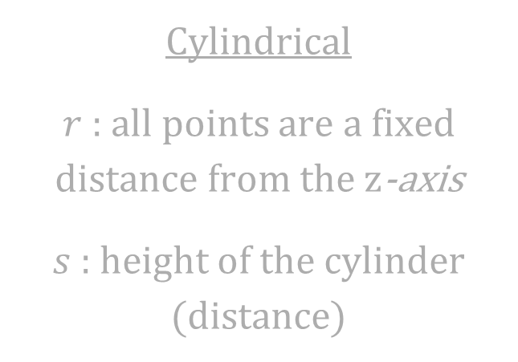
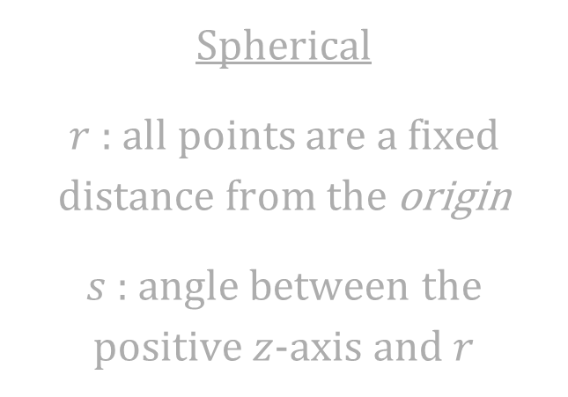
A Comparison of Variables
Cylindrical
$r$ : all points are a fixed distance from the $z$-axis
$s$ : height of the cylinder (distance)
Spherical
$r$ : all points are a fixed distance from the origin
$s$ : angle between the positive $z$-axis and $r$

Slide 16
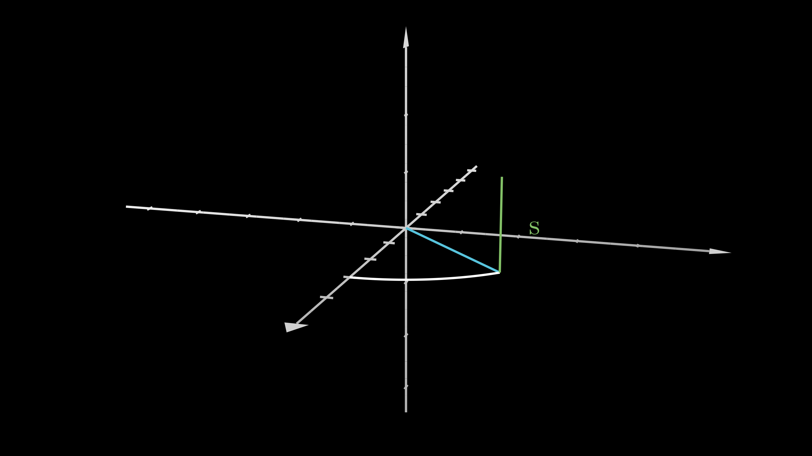
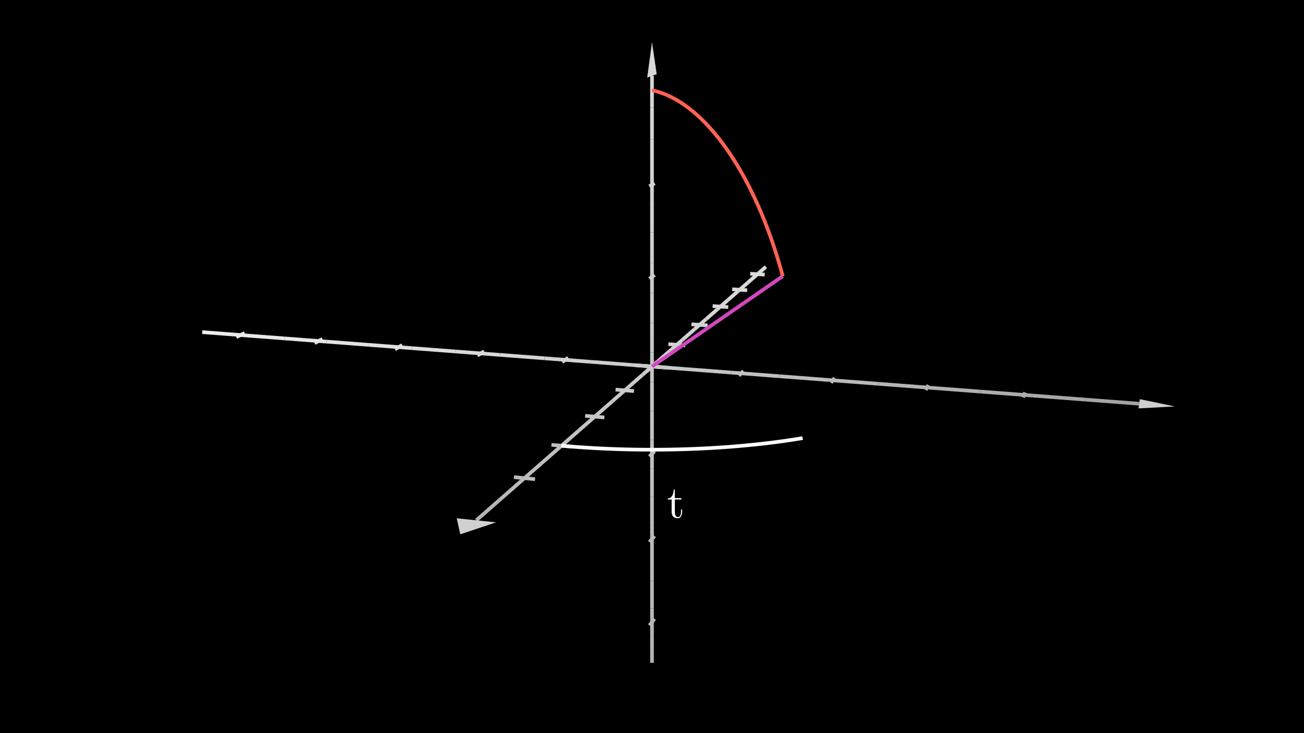
Similarities?

Slide 17
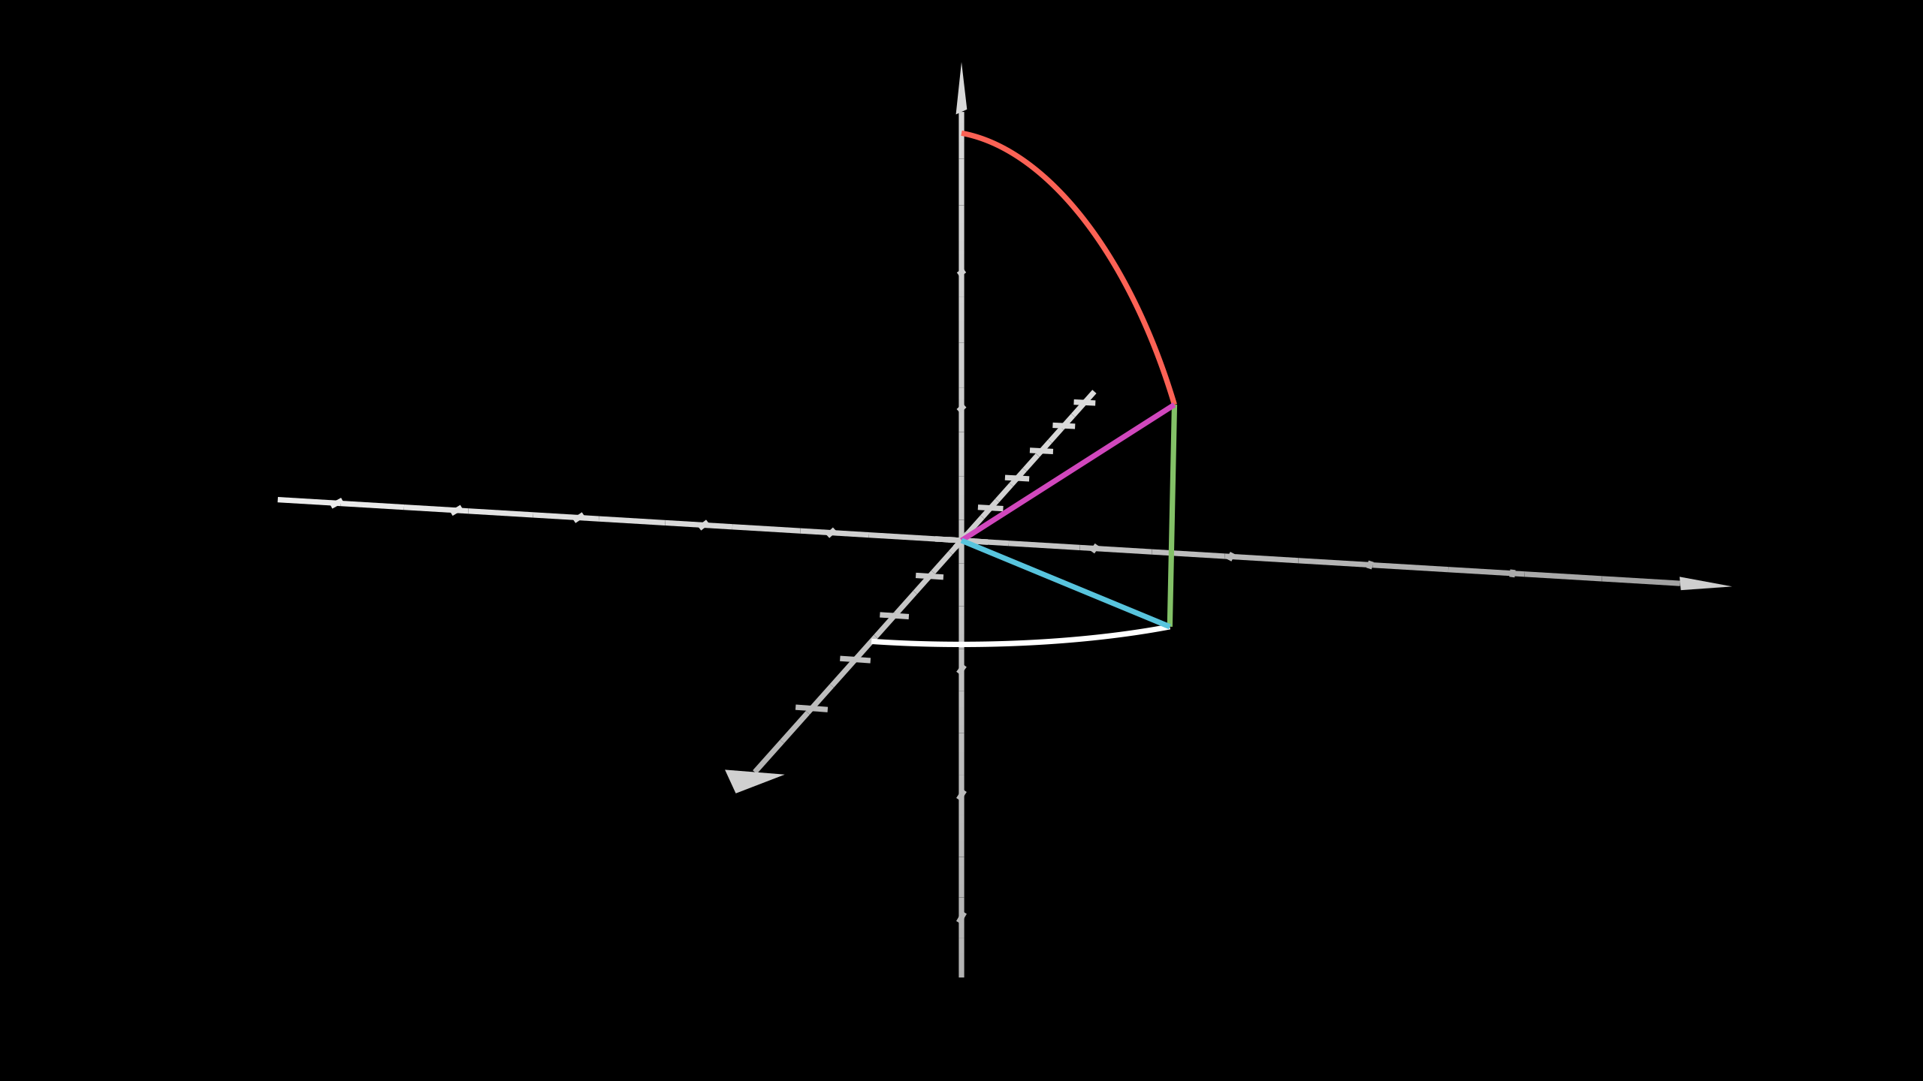
Similarities

Slide 18
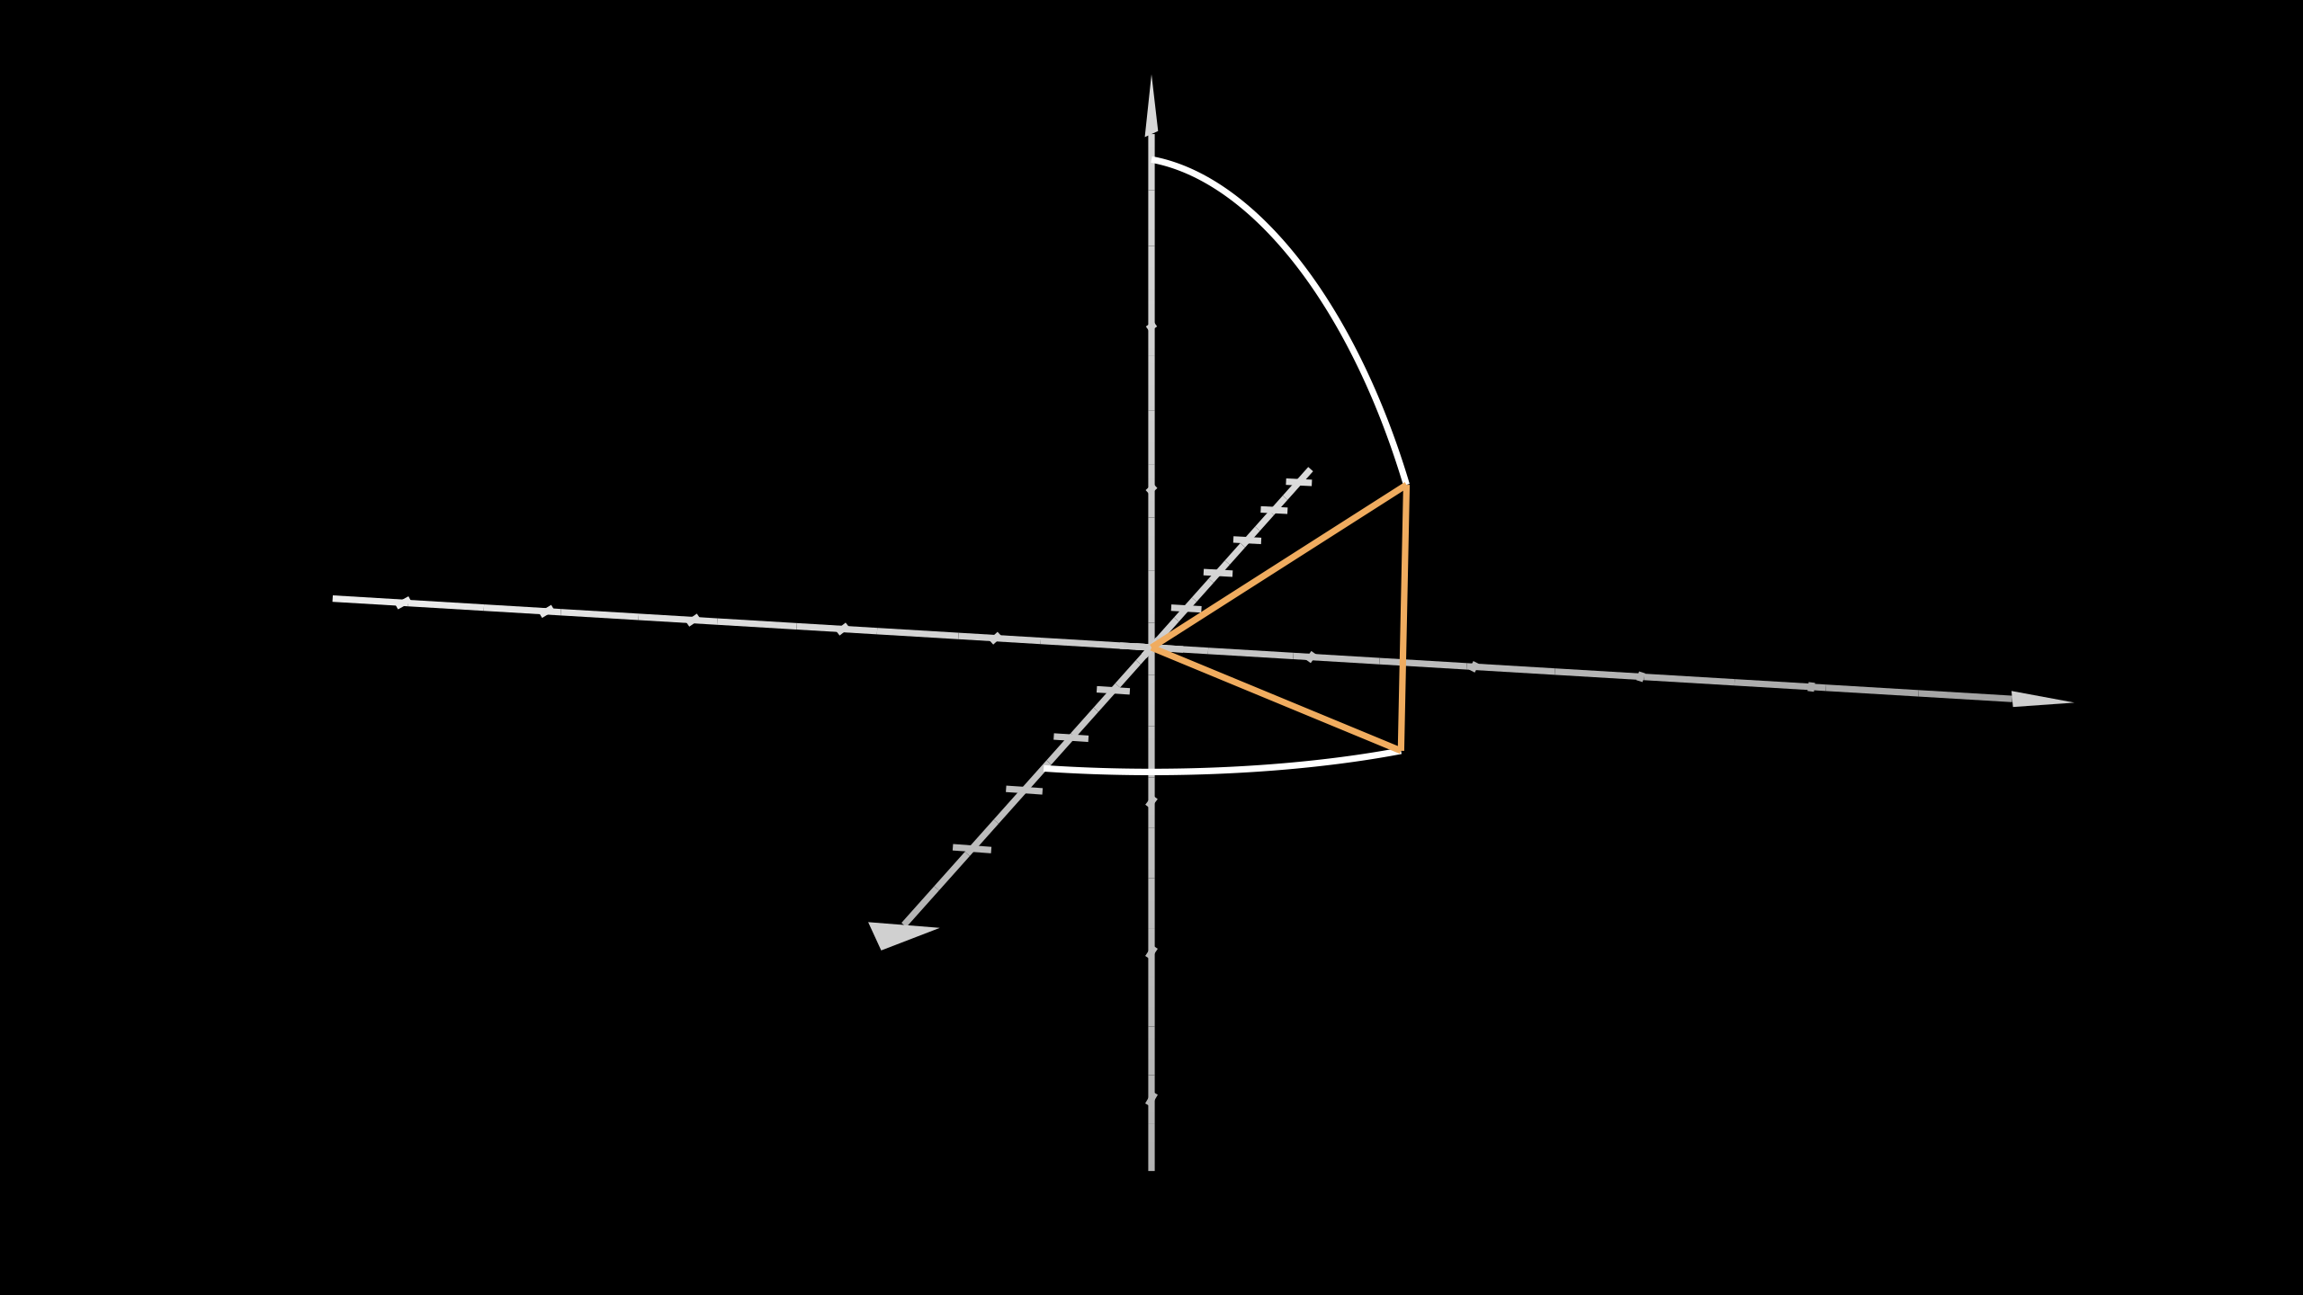
Similarities.

Slide 19
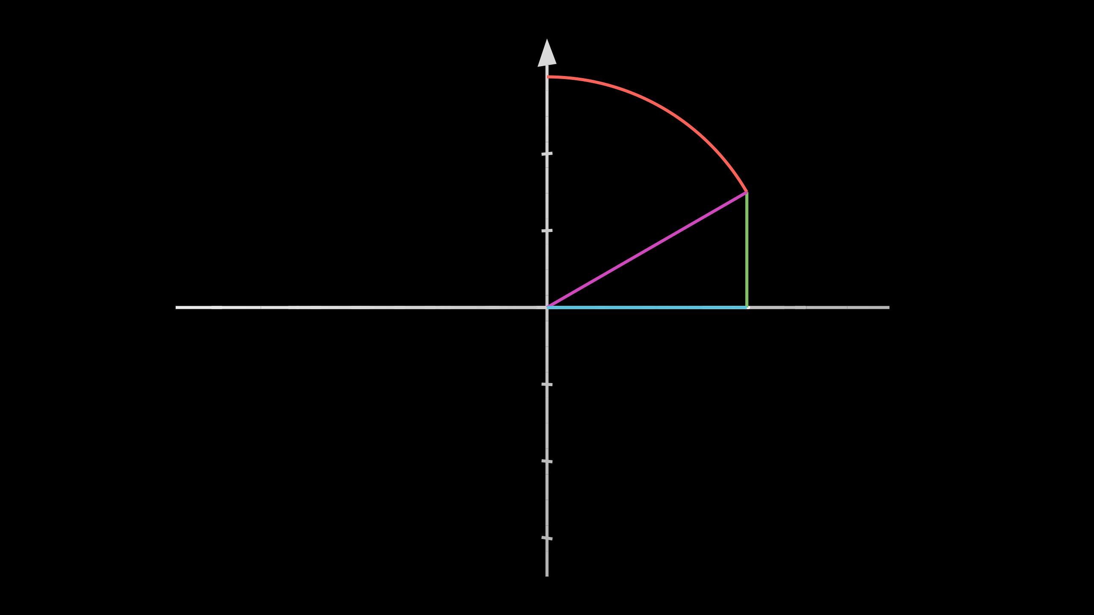
Side View

Slide 20

Side View

Slide 21
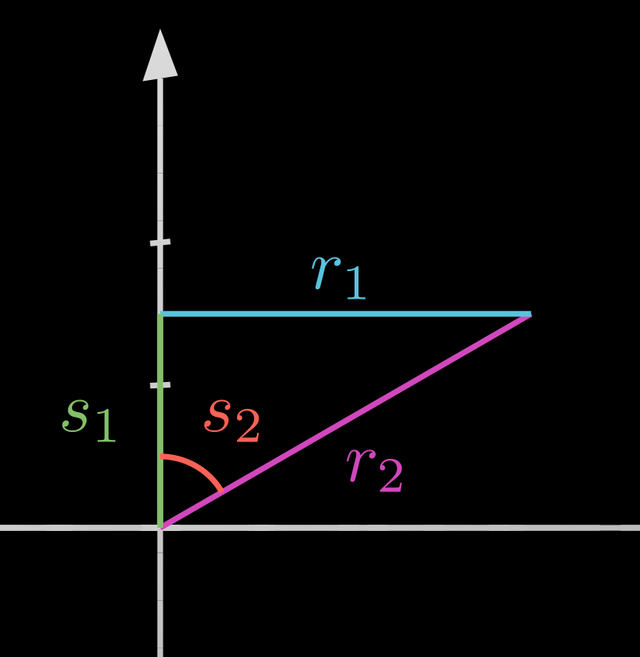
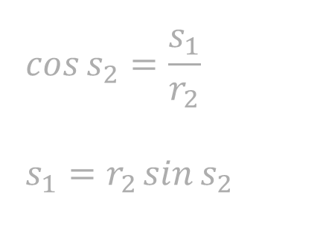
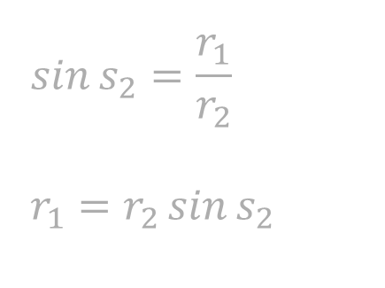

Trigonometry
We want to write $r_{1}$ and $s_{1}$ (cylindrical params) in terms of $r_{2}$ and $s_{2}$ (spherical params):
$$\sin{s_{2}}=\frac{r_{1}}{r_{2}}$$
$$r_{1}=r_{2}\sin{s_{2}}$$
$$\cos{s_{2}}=\frac{s_{1}}{r_{2}}$$
$$s_{1}=r_{2}\sin{s_{2}}$$

Slide 22
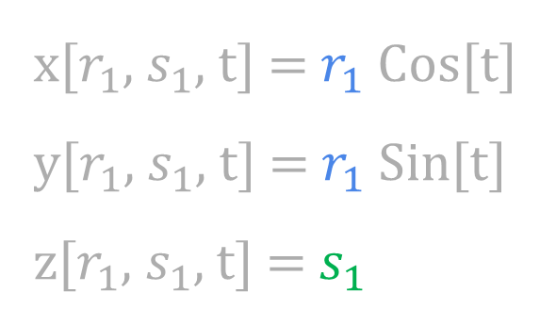
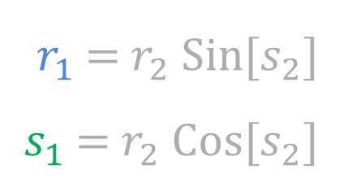
Substitution
x[$r_{1}$, $s_{1}$, t] = $r_{1}$ Cos[t]
y[$r_{1}$, $s_{1}$, t] = $r_{1}$ Sin[t]
z[$r_{1}$, $s_{1}$, t] = $s_{1}$
$r_{1}$ = $r_{2}$ Sin[$s_{2}$]
$s_{1}$ = $r_{2}$ Cos[$s_{2}$]

Slide 23
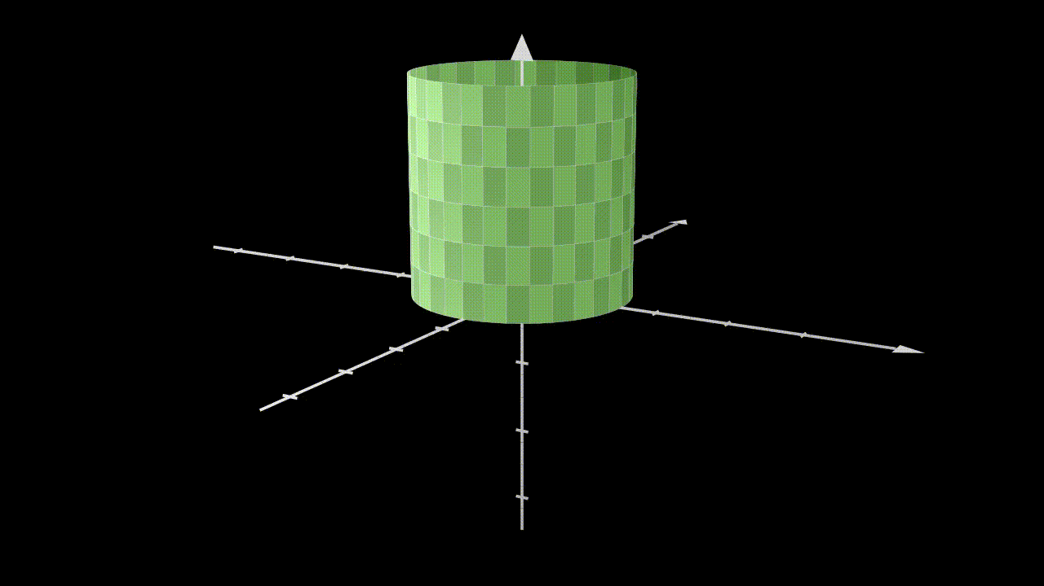
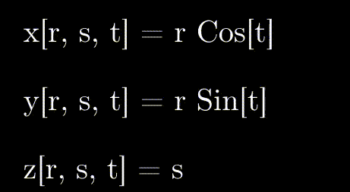
Substitution

Slide 24
Spherical Coordinates
x[r, s, t] = r Cos[t] Sin[s]
y[r, s, t] = r Sin[t] Sin[s]
z[r, s, t] = r Cos[s]

Slide 25
Conceptually—Circular Cross Sections
x[r, s, t] = r Cos[t] Sin[s]
y[r, s, t] = r Sin[t] Sin[s]
z[r, s, t] = r Cos[s]
x[r, s, t] = r Cos[t] Sin[s]
y[r, s, t] = r Sin[t] Sin[s]
z[r, s, t] = r Cos[s]
x[r, s, t] = r Cos[t] Sin[s]
y[r, s, t] = r Sin[t] Sin[s]
z[r, s, t] = r Cos[s]
x[r, s, t] = r Cos[t] Sin[s]
y[r, s, t] = r Sin[t] Sin[s]
z[r, s, t] = r Cos[s]

Slide 26


Bounds
x[r, s, t] = r Cos[t] Sin[s]
y[r, s, t] = r Sin[t] Sin[s]
z[r, s, t] = r Cos[s]
$$0≤r≤r_{0}$$
$$0≤t≤2π$$
$$0≤s≤π$$

Slide 27
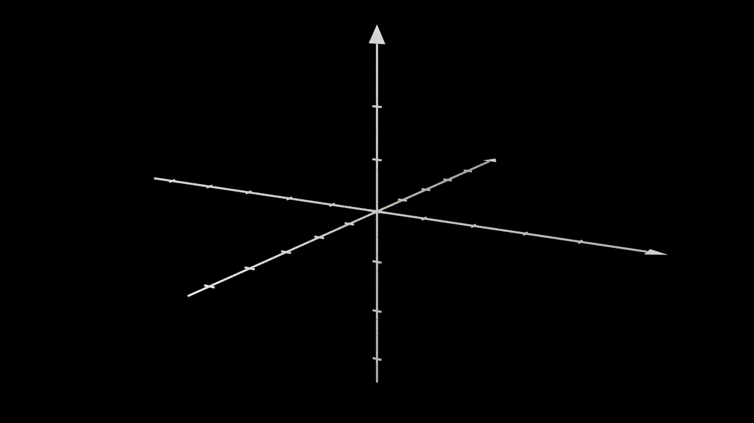


Bounds for $s$

Slide 28
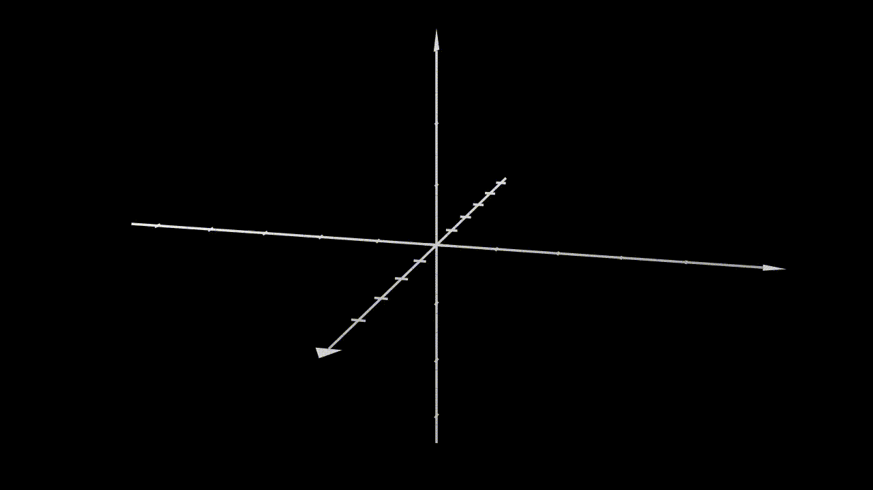

Bounds for $s$

Slide 29



If $s$ goes from $0$ to $2π$

Slide 30
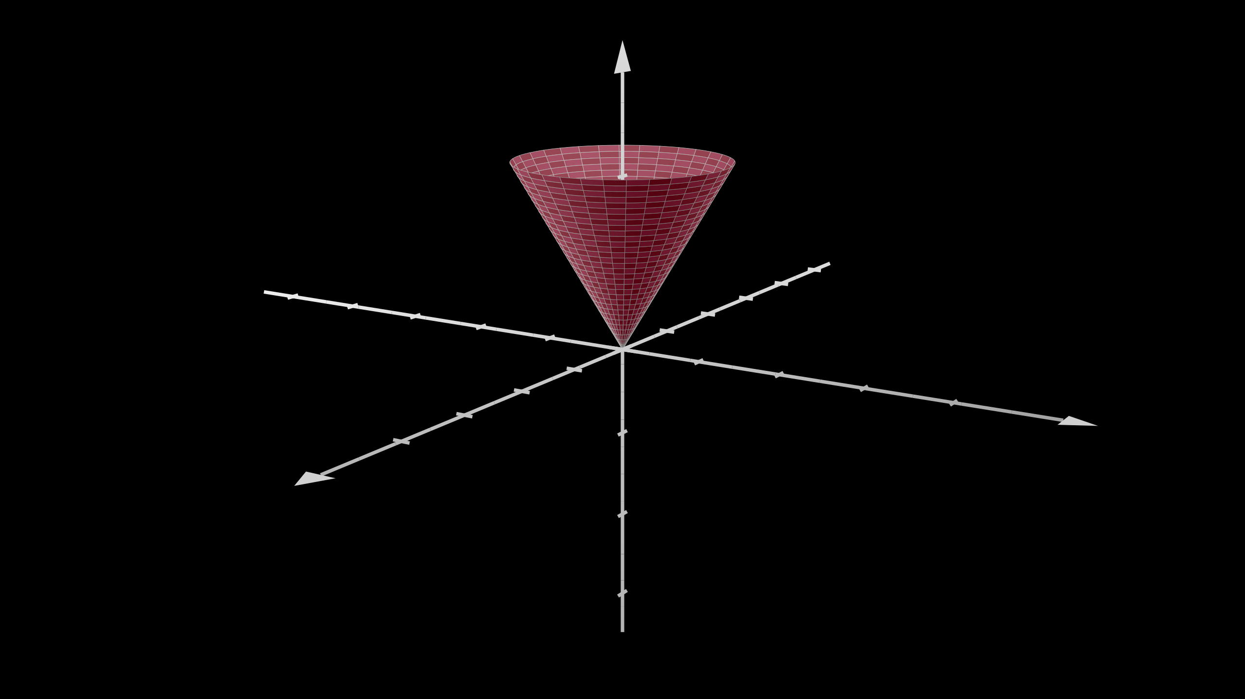
Visualization
What values of $r$, $s$, and $t$ will give us the following surface?

Slide 31
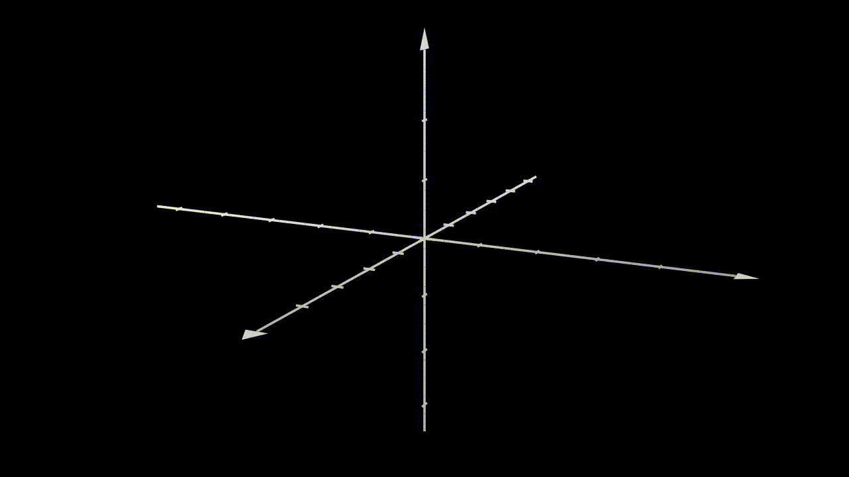
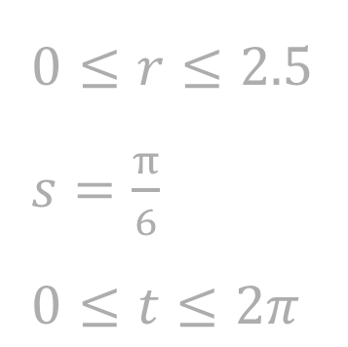
Visualization
$0≤r≤2$.5
$s=\frac{π}{6}$
$0≤t≤2π$

Slide 32
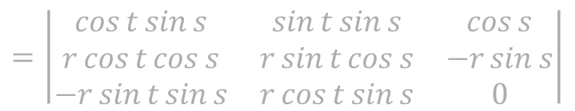
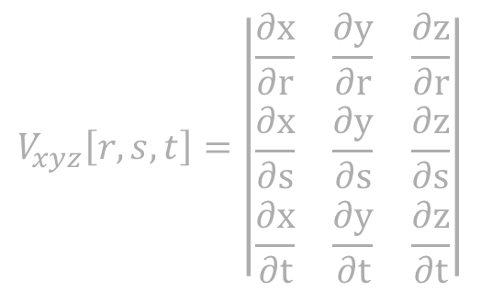
$$V_{xyz}\left[r,s,t\right]$$
{x[r, s, t], y[r, s, t], z[r, s, t]} = {r Cos[t] Sin[s], r Sin[t] Sin[s], r Cos[s]}
$$V_{xyz}\left[r,s,t\right]=\left|\begin{matrix}\frac{∂x}{∂r} & \frac{∂y}{∂r} & \frac{∂z}{∂r} \\ \frac{∂x}{∂s} & \frac{∂y}{∂s} & \frac{∂z}{∂s} \\ \frac{∂x}{∂t} & \frac{∂y}{∂t} & \frac{∂z}{∂t}\end{matrix}\right|$$
$$=\left|\begin{matrix}\cos{t}\sin{s} & \sin{t}\sin{s} & \cos{s} \\ r\cos{t}\cos{s} & r\sin{t}\cos{s} & −r\sin{s} \\ −r\sin{t}\sin{s} & r\cos{t}\sin{s} & 0\end{matrix}\right|$$
$=\cos{t}\sin{s}\left|\begin{matrix}r\sin{t}\cos{s} & −r\sin{s} \\ r\cos{t}\sin{s} & 0\end{matrix}\right|$ $−\sin{t}\sin{s}\left|\begin{matrix}r\cos{t}\cos{s} & −r\sin{s} \\ −r\sin{t}\sin{s} & 0\end{matrix}\right|$ $+\cos{s}\left|\begin{matrix}r\cos{t}\cos{s} & r\sin{t}\cos{s} \\ −r\sin{t}\sin{s} & r\cos{t}\sin{s}\end{matrix}\right|$

Slide 33

$$V_{xyz}\left[r,s,t\right]$$
$$=r^{2}\sin{s}$$

